Slide 1
Machine learning
Regent College London
SWE6204

Slide 2
Machine learning
SWE6204

Slide 3

Machine learning
NAÏVE BAYES TECHNIQUE

Slide 4
Module 1 – NAÏVE BAYES TECHNIQUE

Slide 5
Learning objectives
Understand the Bayes theorem
Understand the how Naïve Bayes algorithm work

Slide 6
Bayes theorem
𝑃(𝐴|𝐵) =𝑃( 𝐴 ) 𝑃( 𝐵|𝐴 ) / 𝑃( 𝐵 )
Let’s use it for machine learning! I want a spam classifier.
Example: how would we express the probability of an email being spam if contains the word “free”?
𝑃(𝑆𝑝𝑎𝑚 | 𝐹𝑟𝑒𝑒)=𝑃(𝑆𝑝𝑎𝑚)𝑃(𝐹𝑟𝑒𝑒 |𝑆𝑝𝑎𝑚) / 𝑃(𝐹𝑟𝑒𝑒)

Slide 7
Bayes theorem
The numerator is the probability of a message being spam and containing the word “free” (this is subtly different from what we’re looking for)
The denominator is the overall probability of an email containing the word “free”. (Equivalent to P(Free|Spam)P(Spam) + P(Free|Not Spam)P(Not Spam))
So together – this ratio is the % of emails with the word “free” that are spam.

Slide 8
What about all the other words?
We can construct P(Spam | Word) for every (meaningful) word we encounter during training
Then multiply these together when analysing a new email to get the probability of it being spam.
Assumes the presence of different words are independent of each other – one reason this is called “Naïve Bayes”.

Slide 9
Python coding
Scikit-learn to the rescue!
The CountVectorizer lets us operate on lots of words at once, and MultinomialNB does all the heavy lifting on Naïve Bayes.
We’ll train it on known sets of spam and “ham” (non-spam) emails
▫ So this is supervised learning!
Let’s do this

Slide 10
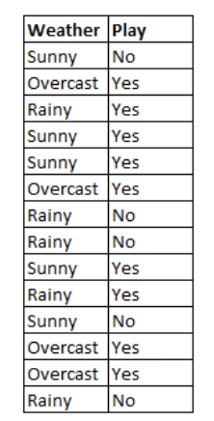
How naïve Bayes algorithm works?
Let’s understand it using an example. Below I have a training data set of weather and corresponding target variable ‘Play’ (suggesting possibilities of playing). Now, we need to classify whether players will play or not based on weather condition. Let’s follow the below steps to perform it.
Step 1 - Convert the data set into a frequency table
Step 2 - Create Likelihood table by finding the probabilities

Slide 11
Frequency table
 | Frequnecy Table
Weather | No | Yes
Overcast
Rainy
Sunny
Total

Slide 12
Likelihood table
 | Likelyhood Table
Weather | No | Yes
Overcast |  | 4 | 0.29
Rainy | 3 | 2 | 0.36
Sunny | 2 | 3 | 0.36
Total | 5 | 9
 | 0.36 | 0.64

Slide 13
Probabilty
P(Yes|Sunny) ?

Slide 14
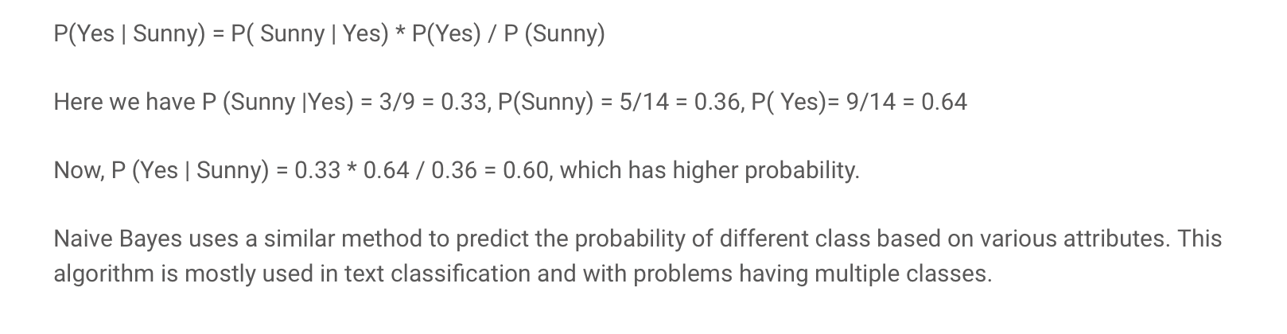
answer

Slide 15
+44 (0)207 016 8000
info@rcl.ac.uk

